Slide 1
Work Breakdown Structure

Slide 2
Introduction
A work break down structure (WBS) is a tool that ensures that no important deliverables within a project have been left out.
Since a WBS is always outcome oriented, it can act as the best tool to improve performance of the existing prescriptive methods of a project and assist in its completion.
Work Breakdown Structure (WBS) is a tool for organizing and defining the total scope of a project with use of a hierarchical tree structure

Slide 3
Preliminary Summary of the Project Schedule
The project schedule will begin with a planning phase
The second stage in the project schedule is the decision stage for the project
The third stage will include execution phase
The fourth stage is the control phase
The last stage will includes analysis of performance

Slide 4
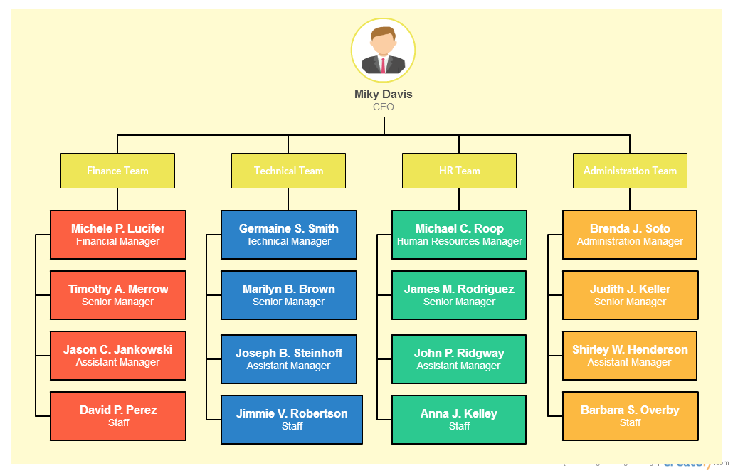
Work Break Structure
Notes:
PROJECT IDENTIFICATION
Project Planning
Action Plan
Execution Phase
Risk Assessment
Control Phase
Monitoring Initiatives
Project Evaluation

Slide 5
Preliminary Budget Plan (Allocated Budget)
ITEM | COST
Conducting surveys | $10000
Planning Budget | $3000
Contractual costs | $5000
Managements Costs | $8000
Project costing | $6000
Capital expenses | $3000
Monitoring of performance | $4000
Documentation | $1000
Total Budget | $40000
Notes:
There are several return of investment from the above budget that can be identified. It is evident that the internal processes usually drive the success of the business. For this reason, establishing effective approaches in dealing with those processes is a major way of achieving improved business success. One of the most significant returns of investment metric is improved performance. The organization shall be using performance contracts to identify how the employees have improved over time and how they can be used to help the organization achieve improvements in performance over time. This is one of the most significant factors that can help the management to engage the organization in achieving transformations over time.

Slide 6
Execution Phase
The strategies to be used in the project include
Risk avoidance
Risk control
Risk transfer
Risk assumption
Notes:
These risks are spread throughout the project life-cycle and there is need for project manager to regularly assess potential new risks likely to affect project completion. There are five strategies to use to counter their effects. These include risks avoidance, risk control, risks assumption and risk- transfer. Their application is greatly influenced by individual perception and nature. For instance, risk-aversive and risk-taker managers are likely to prefer different strategies

Slide 7
Conclusion
To sum it up, when a project is falling behind schedule and time, it can be referred to the WBS to help identify loopholes and deliverables that can help to enhance its completion.
The attempting to complete a management project without a Work Breakdown Structure (WBS) is like attempting to navigate in a strange maze without a map or a strategy
Its clear that a WBS helps the project managers to efficiently allocate all the essential resources for a project.
Notes:
To sum it up, when a project is falling behind schedule and time, it can be referred to the WBS to help identify loopholes and deliverables that can help to enhance its completion. The attempting to complete a management project without a Work Breakdown Structure (WBS) is like attempting to navigate in a strange maze without a map or a strategy
Its clear that a WBS helps the project managers to efficiently allocate all the essential resources such as people, places and the money within the project.

Slide 8
References
Hitt, M., Ireland, R. D., & Hoskisson, R. (2012). Strategic management cases: competitiveness and globalization. Cengage Learning.
Norman, E. S., Brotherton, S. A., & Fried, R. T. (2008). Work breakdown structures: The foundation for project management excellence. Hoboken, N.J: John Wiley & Sons.
Biafore, B. (2010). Microsoft Project 2010: The missing manual. Beijing: Pogue Press/O'Reilly.
Haugan, G. T. (2002). Effective work breakdown structures. Vienna, Va: Management Concepts.

